Slide 1
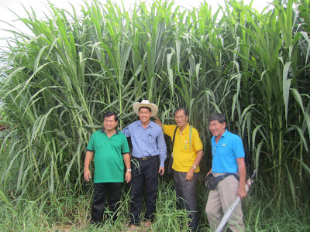
Biomass | Average Cellulose | Average Hemi cellulose | Average Lignin/Insolubles | Average C6 Glucose | Average C5 Xylose
 | Kg/Dry Ton | Kg/Dry Ton | Kg/Dry Ton | Kg/Dry Ton | Kg/Dry Ton
Pakchong 1 Super Napier | 373 | 202 | 432 | 411 | 170
A new foliar fertilizer formulation can accelerate the growth of Pakchong 1, also popularly called Super Napier, up to 15 feet tall in just 70 days from planting. And the amazing part is that the yield can be more than a thousand tons of herbage per hectare in just one cutting. The new liquid foliar fertilizer, called VB Tall, is a formulation of Alfonso G. Puyat who has been doing a lot of research on plant growth accelerators. Earlier, he invented the ‘Power Grower Combo’ and the’ Heavy Weight Tandem’ which have become popular with farmers because of their efficacy in accelerating the growth of various crops that also results in much higher yields. Rodrigo B. España, an accredited researcher of the Fertilizer and Pesticide Authority (FPA), conducted the research on the efficacy of VB Tall on Super Napier in his research station in Brgy. San Jose, General Santos City.

Slide 2
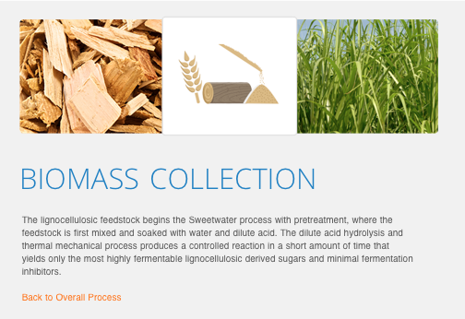
Two Technology Providers
Convert Cellulose to C5 / C6 Sugars and Lignin
AMG Energy, Melbourne, FL, utilizes a dry catalyst [Kaolin] to break down the cellulose in a rapid 30-minute process at only 100˚ F. However, they do not evidence a method for separating C5 and C6 sugars. They are under financed and will require more support to fulfill our requirements.
Sweetwater Energy, Rochester, NY has had much better backing from VC and state (Minnesota) support for a major pilot plant in a Forestry application. The feedstock is first mixed and soaked with water and dilute acid. This pretreatment yields lignocellulosic derived sugars and minimal fermentation inhibitors. The lignocellulosic stream is separated from the clean lignin product. The pretreated material, either C6-rich or as a C5/C6 mixed sugar blend, is sent to an enzymatic hydrolysis stage. Sweetwater has the ability to separate the cellulosic-derived C5 rich stream – or the C5/C6 blended hydrolysate can be prepared for enzymatic hydrolysis. Uniquely, their proprietary technology allows for blended C5/C6 sugar streams or isolated C5 and C6 streams.

Slide 3
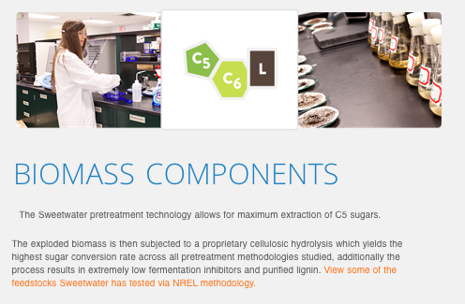

Slide 4
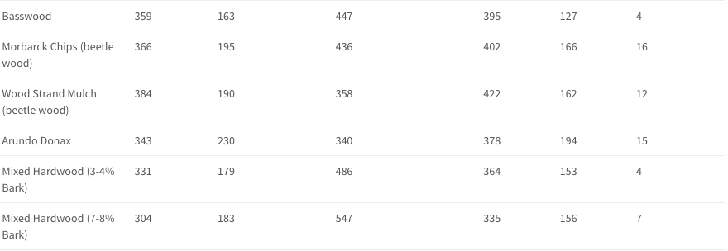
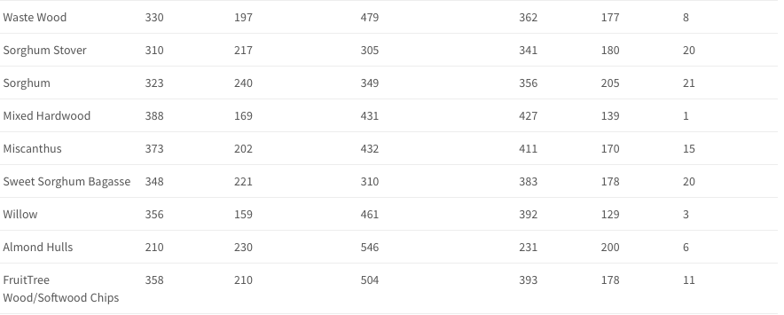

Slide 5
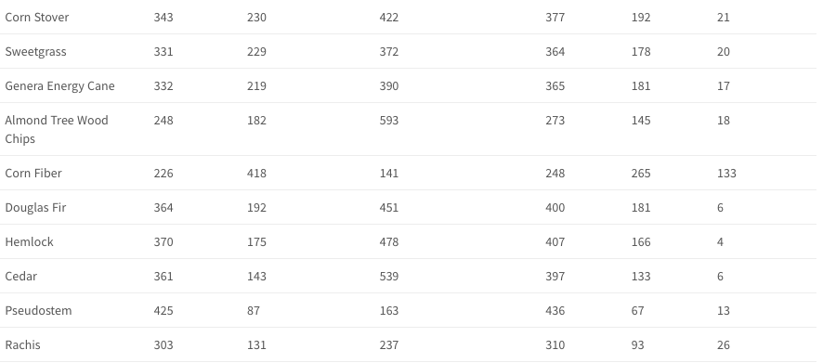

Slide 6
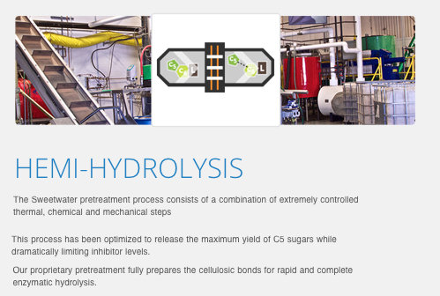
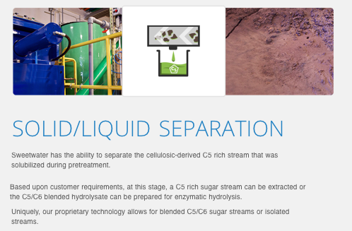

Slide 7
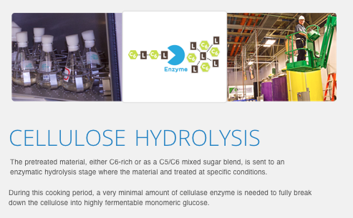

Slide 8
