Slide 1
Local Beneficiation Program I N D I A
A Partnership between Technology and Its Host Country Work Force

Slide 2
G.R. Langworth, of Energy Giant LLC (HK / SA) has teamed with B.A. Jaafar (MY / SA) in assembling Intellectual Property Rights (IPR from FloChem USA and other new technology providers) along with the funding to build and operate transportable factory modules to manufacture high-value products on site of mineral feedstocks in India – mutually benefiting the host country’s collaborating population and the enterprise.

Slide 3
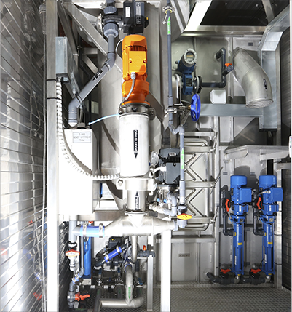
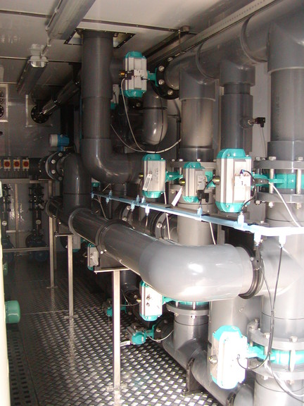
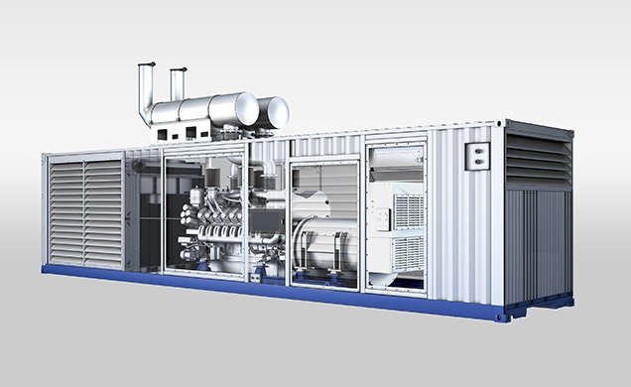
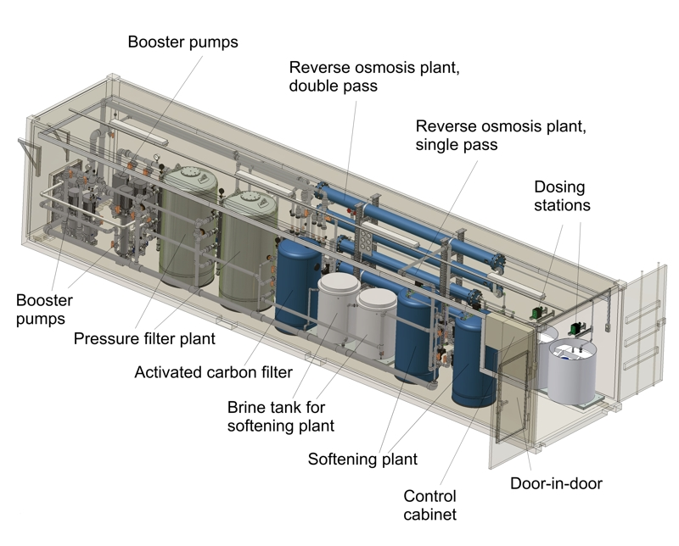
Convert NG to H₂ and
Highly-branched Naphtha
Hydrocrack Dirty Brown Coal into Pure Diesel and Jet Fuel
Factories in 40-ft. Containers
Convert Highly-branched Naphtha to Elastomer feedstocks for Synthetic Rubbers

Slide 4
The S2J™ hydrocracking reaction is self-sustaining requiring no heat input, whereas forming the Syngas for FT incurs a super-penalizing endotherm, at super refractory hard-to-manage temperatures, often exceeding 1300˚ C.
Our mild energy input is generating hydrogen and highly branched Naphtha from natural gas. Less than 300˚ C. in both S2J™ and H2H™ systems.
Our processes require less than 20 atmospheres vs Fischer-Tropsch’s [FT] 80 atmospheres for Syngas
The S2J™ hydrocracking is energy self-sufficient [running at less than 300˚ C].
The H2H™ source of H₂ requires energy input of 2.1 MW hours per MT of Natural Gas processed, [yielding ~ 7 metric tons of diesel / jet fuel]
For FT to make 7 tons of final product, it requires 20-25 MW-hours of energy. Using O₂ separations from air easily adds from 5 to 15 MW-hours of additional energy overhead to this.
FT’s generated paraffin wax will require significant additional processing, compared to our diesel and jet fuel – penalizing FT with doubled to tripled refining costs compared to our S2J™ / H2H™ processes.
FloChem USA employs poison-proof fluid catalysts with unlimited life-times, unlike FT’s solid catalysts which are consumed in operation, and are a major operating expense
FloChem pure diesel and jet fuel will be sulphur-free, metals-free, have 10%+ higher caloric value and ~40% less NO_{x} pollutants than conventional diesel and jet fuel..

Slide 5
Beneficiation Facilities Will Site at HAZIRA LNG PORT in Gujrat, India
Convert NG to H₂ and
Highly-branched Naphtha
Hydrocrack Dirty Brown Coal into Pure Diesel and Jet Fuel
COAL BENEFICIATION
Each site will produce :
. Low-Polluting Sulfur and Metals Free Diesel: 321,048 Gallons x3.78541=1,215,29.31 Litres = 1019,544 MT per hour or 24,469.056MT per day
Low-Polluting Sulfur and Metals Free Jet Fuel: 137,592 Gallons x 3.78541=520,42.13Litres= 364.736MTper hour or 8753.664MT per day
Highly-Branched Naphtha:138.84MT per hour or 3,332.16MT per day
ANNUAL PRODUCTION
8.564 Million MT Diesel,
3.063 Million MT Aviation Turbine Fuel and
1.166 Million MT of Highly-Branched Naphtha

Slide 6
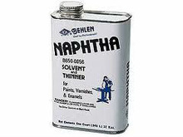
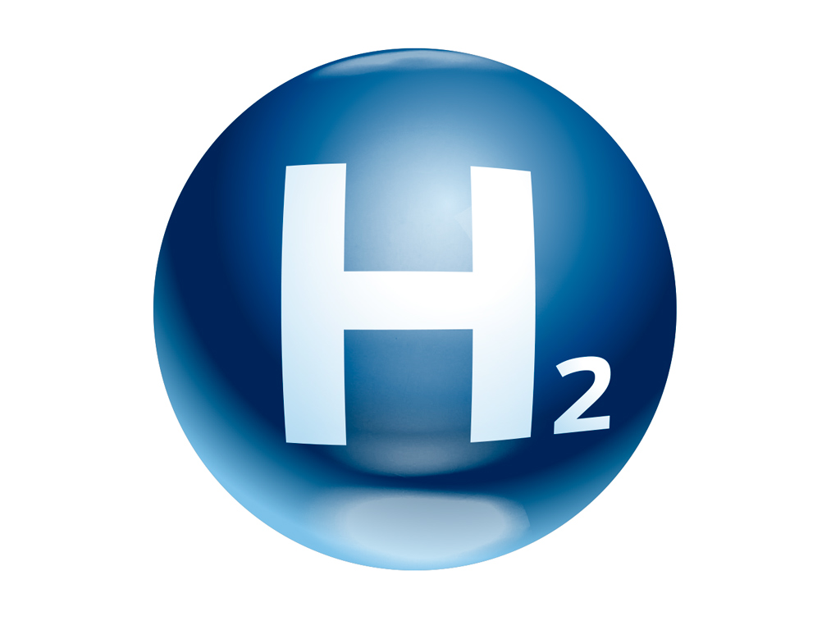
H2H™
Factory Module
13 mt of NG per hour
27.3 MW per hour
1.43 mt per hour
11.57 mt per hour

Slide 7
S2J™
Factory Module
91 mt per hour
1.092 mt per hour
20,065 gallons per hour
8,599 gallons per hour

Slide 8
H2H™ modules
4.29 mt per hour
34.7 mt per hour
1,456 mt of coal per hour
S2J™ modules
80,260 gallons per hour
34,398 gallons per hour
Configuration of H2H™ modules supporting S2J™ modules

Slide 9
17.16 mt per hour
138.84 mt per hour
1,456 mt of coal per hour
321,040 gallons per hour
137,592 gallons per hour
Beneficiation Site in HAZIRA, GUJARAT INDIA

Slide 10
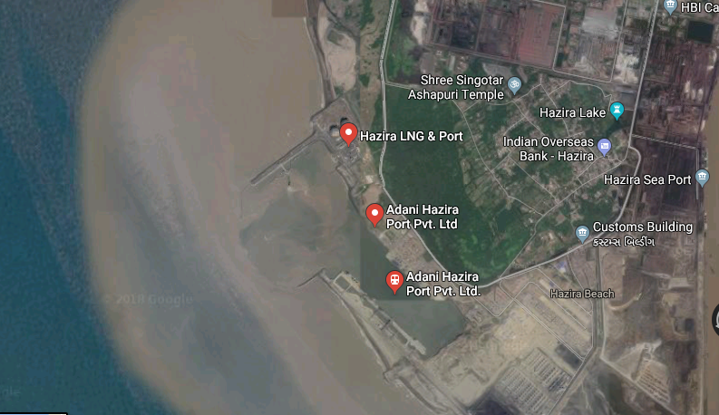
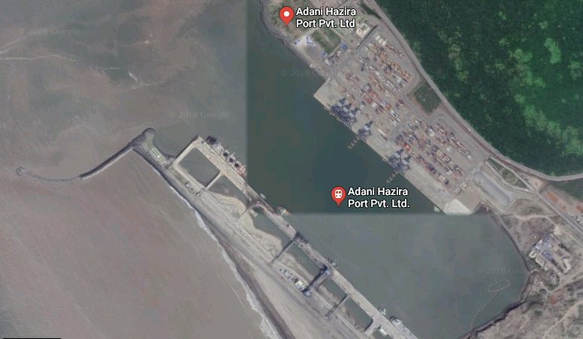

Slide 11
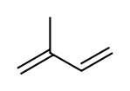
Convert Highly-branched Naphtha to Elastomer feedstocks for Synthetic Rubbers
Our custom-tailored Elastomeric Plastic Facility is expected to be capable of producing circa 80% of the monomers it will require via pyrolysis of Highly-branched Naphtha. Yields of mono-enes and di-enes from ‘Hi-Naphtha’ feedstocks should run around 70% and ~10% respectively.
Several Millions of metric tons of ‘Hi-Naphtha’ will be manufactured locally and shipped to this facility. This ‘Hi-Naphtha’ feedstock will generate high quantities of mono-enes that are considerably higher in Mol.Wt. than even isobutylene and range from Neohexene (C6) to highly-branched olefins of 9-10 total Carbons.
About 1/7th of the weight of dienes are expected compared to olefins/mono-enes, and diene Mol.Wt.'s should run from 1-2 C's higher than that of olefins.
Due to the Facility's feedstocks and their highly-branched nature, no or Very little (linear) Butadiene will result, and even Isoprene in yields exceeding ~2% would be very surprising.
Multiple-Methyl-branched dienes such as 3,5,5-trimethyl-1,3-hexadiene and similar precursors for Tête's world-unique elastomers will certainly exceed in concentration that of Isoprene, the latter being simple mono-methylated 2-methyl-1,3-butadiene:
The maximum production volumes of total polymers at Tête probably won't exceed about 75% of those of its "hi-Naphtha" feedstocks.
-- FloChem USA

Slide 12
Financial View
An initial investment of US $5 billion is planned, augmented by accumulated capital expenditures of up to $ US 7 billion.

