Slide 1
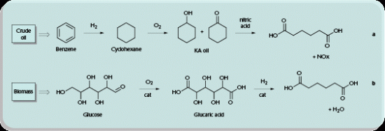
Convert C6 Dextrose to Adipic Acid & Omega-7
Adipic acid is one of the most produced commodity chemicals worldwide. The 2017 global market size is projected at 6 billion pounds. Adipic acid is a versatile building block for an array of processes in the chemical, pharmaceutical and food industries. Its primary use is as a precursor for the synthesis of polyamide Nylon-6,6.
Rennovia, Inc., of Menlo Park, CA uses a bio-based chemical process initially exploiting conventional carbohydrates, e.g. C6 glucose.

Slide 2
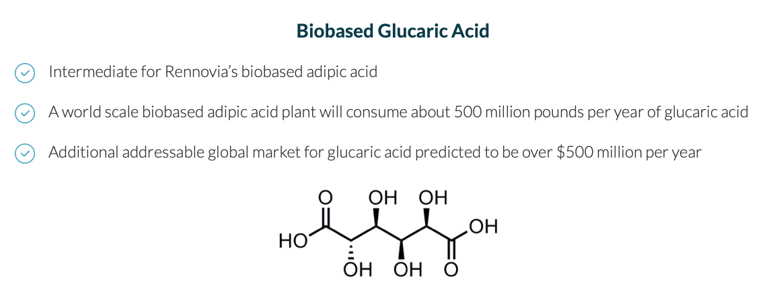
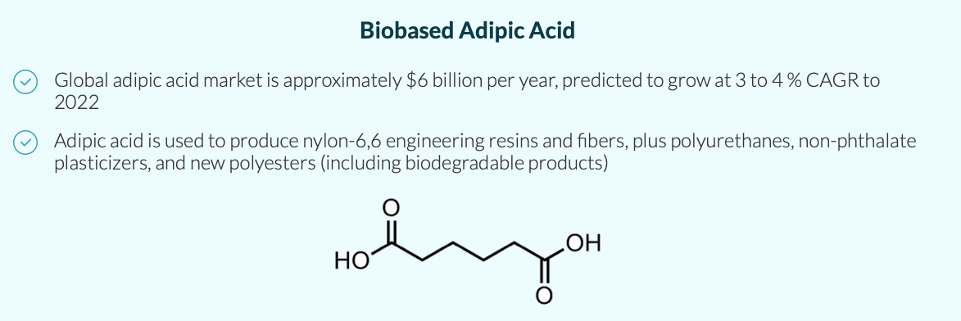

Slide 3
