Slide 1
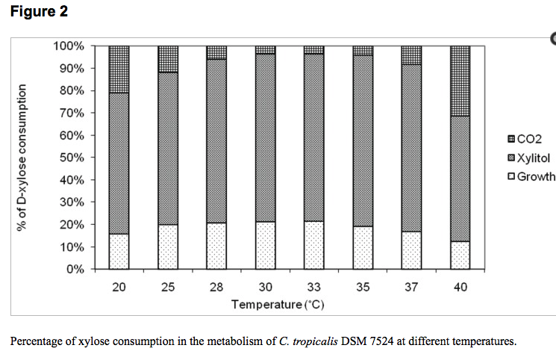
Convert C5 Xylose to Xylitol
Elena Tamburini, Stefania Costa, Maria Gabriella Marchetti, & Paola Pedrini of the Department of Life Sciences and Biotechnology at the University of Ferrara, Ferrara, Italy have demonstrated the optimised production of xylitol from xylose using a Hyper-cidophilic Candida tropicalis.
The yeast Candida tropicalis produces xylitol, a natural, low-calorie sweetener, by fermentation of xylose. In order to increase xylitol production rate during the submerged fermentation process, some parameters substrate (xylose) concentration, pH, aeration rate, temperature and fermentation strategy have been optimized. The maximum xylitol yield was 83.66% on consumed xylose in micro-aerophilic conditions. The hyper-acidophilic behaviour of C. tropicalis makes this strain particularly promising for industrial application, due to the possibility to work in non-sterile conditions.

Slide 2
Xylitol production by Saccharomyces cerevisiae overexpressing different xylose reductases using non-detoxified hemicellulosic hydrolysate of corncob
Abstract
Xylitol production was compared in fed batch fermentation by Saccharomyces cerevisiae strains overexpressing xylose reductase (XR) genes from Candida tropicalis, Pichia stipitis, Neurospora crassa, and an endogenous gene GRE3. The gene encoding a xylose specific transporter (SUT1) from P. stipitis was cloned to improve xylose transport and fed batch fermentation was used with glucose as a cosubstrate to regenerate NADPH. Xylitol yield was near theoretical for all the strains in fed batch fermentation.

